Slide 1
Text clustering from internship comments
Gloria Ainebyona
Student no: 2100702283
Reg No: 2021/HD05/2283U

Slide 2
Objectives
Create a corpus from the data.
Train a clustering algorithm.
Classifies comments into Excellent, Good, Neutral, Poor and Very Poor.
Train an NER model to detect entities.

Slide 3
Data exploration and processing
Dataset was from https://www.fams-cit.com/fscomments
It was about comments from supervisors to interns at their respective organizations.
Data size
4968 rows.
2 columns.
Features are;
Comment_id
Comment

Slide 4
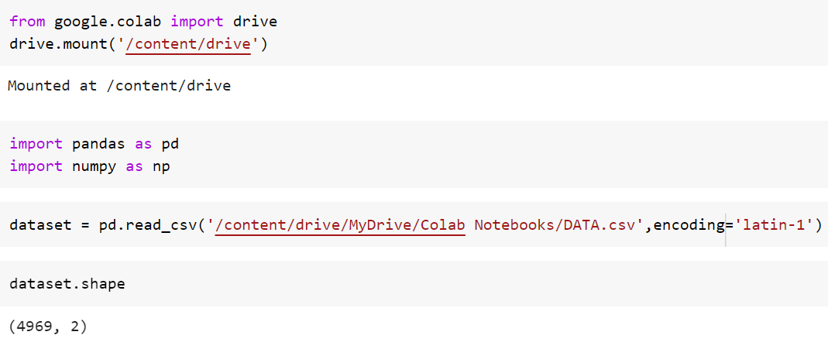
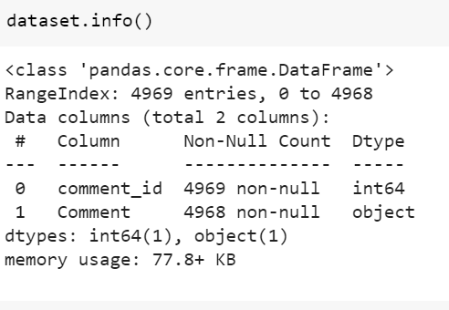
Data loading and exploration

Slide 5
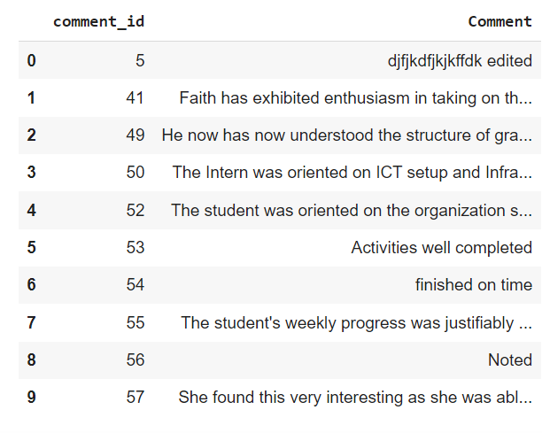
Data exploration

Slide 6
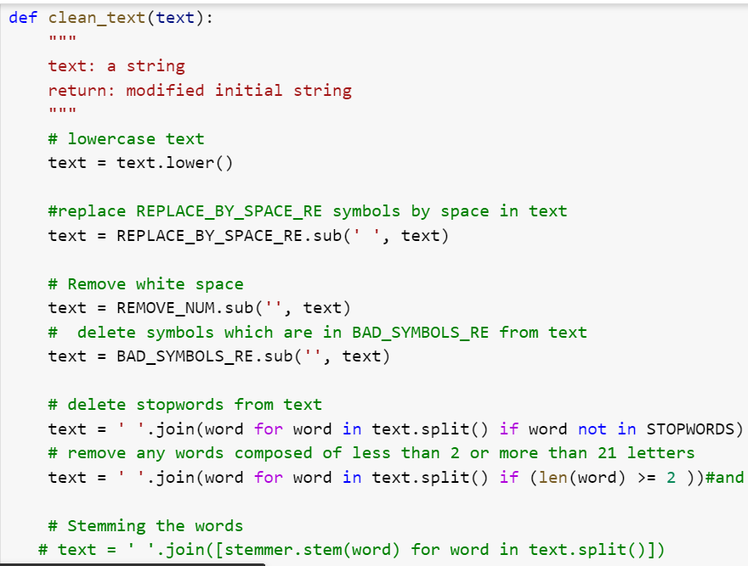
Data cleaning

Slide 7
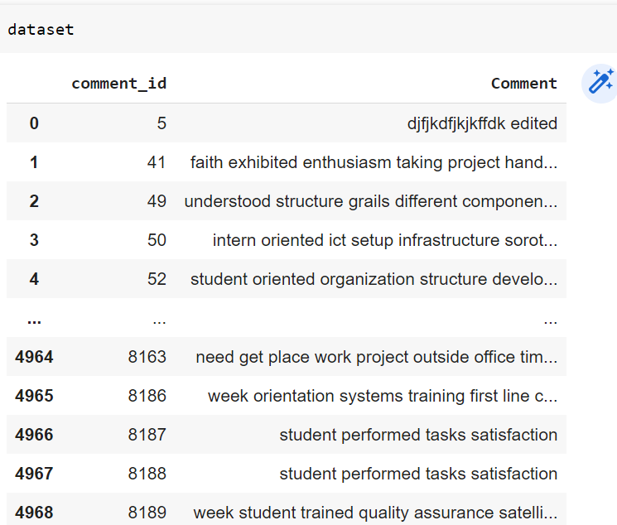
Corpus

Slide 8
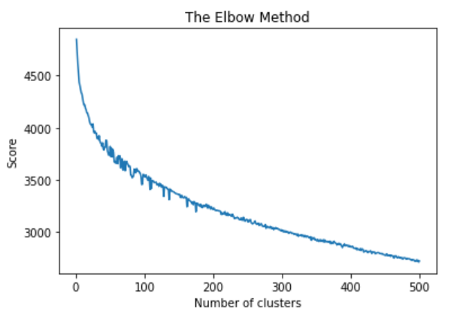
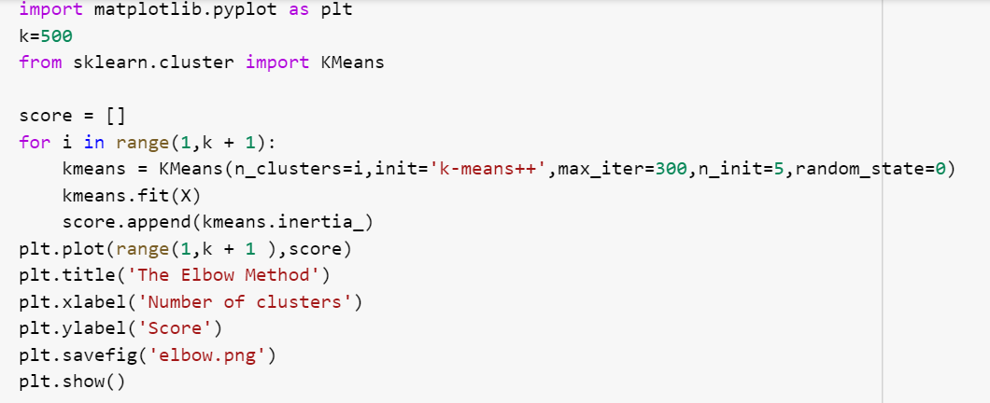
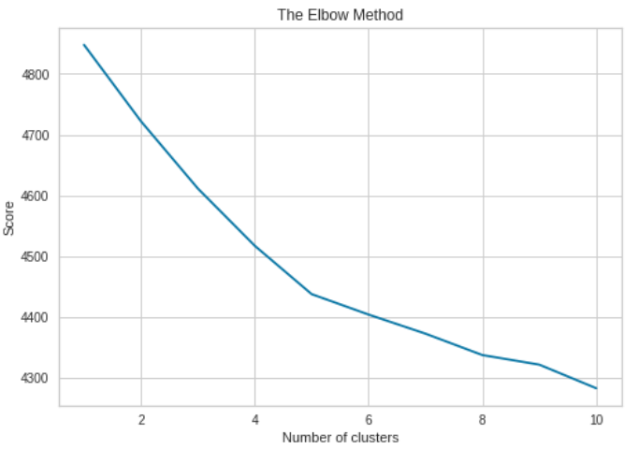
Finding the optimum k value

Slide 9
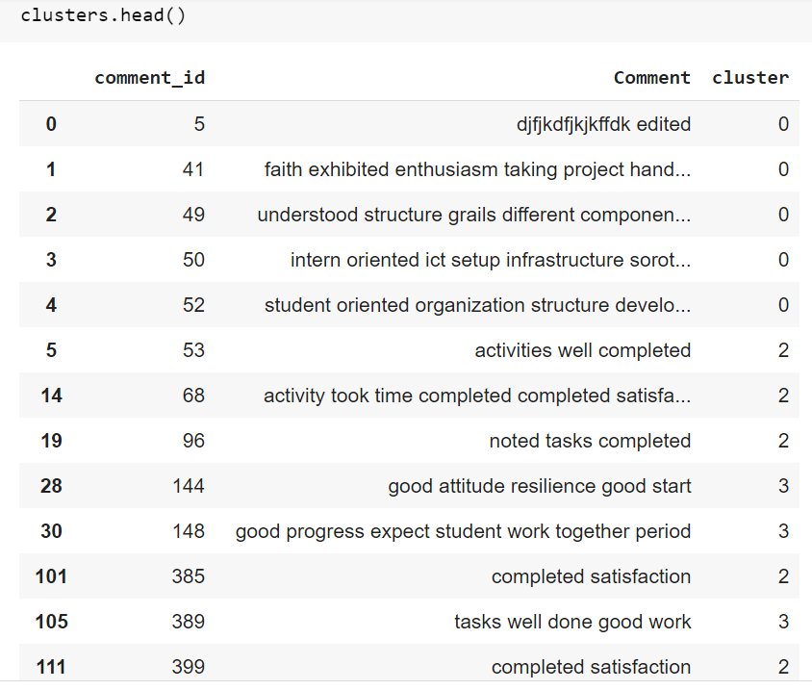
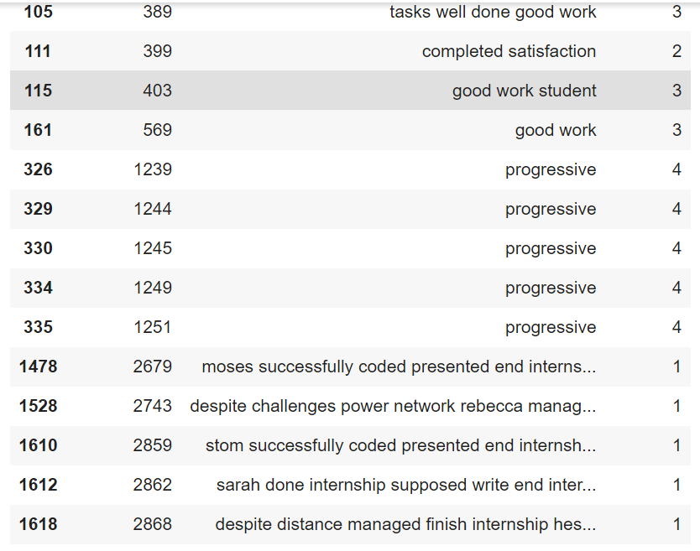
Output : K=5

Slide 10
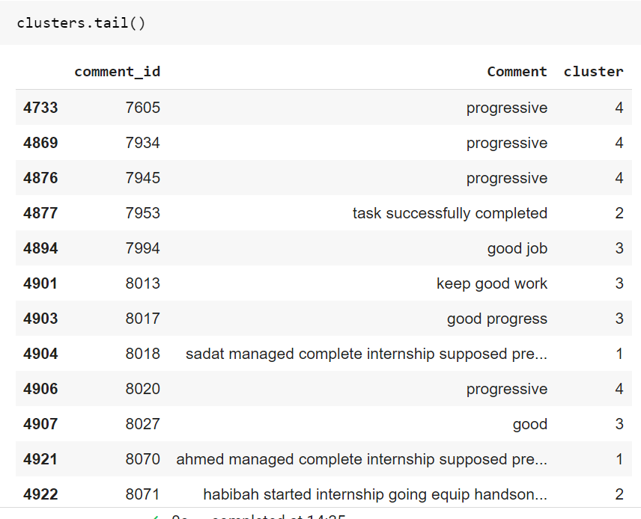
Output: K=5..

Slide 11
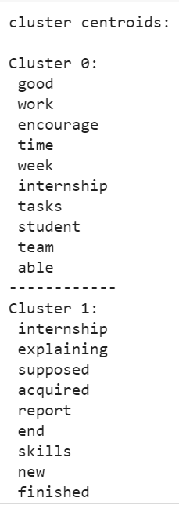
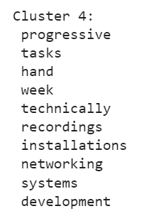
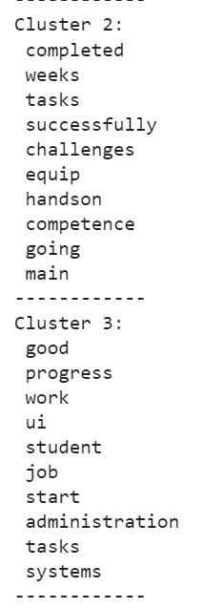
Centroids of clusters

Slide 12
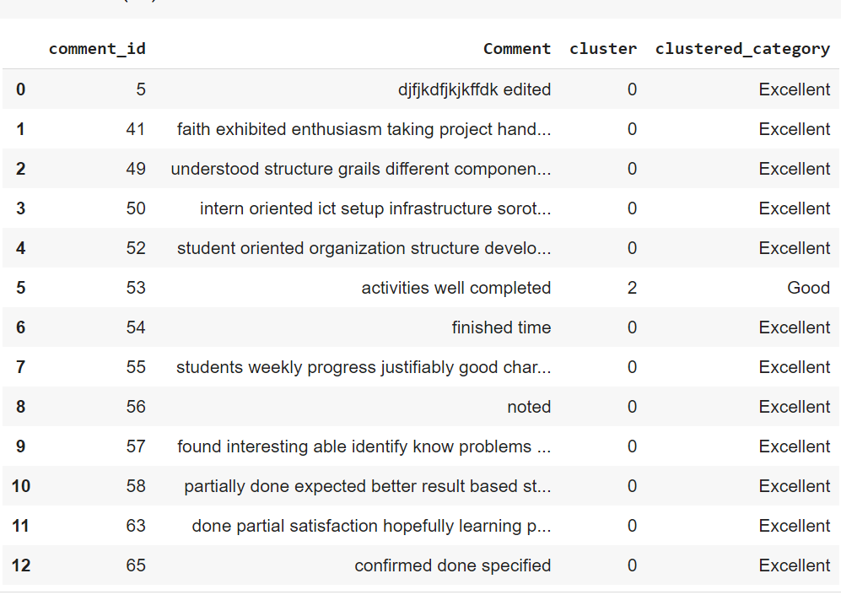
Comments category

Slide 13
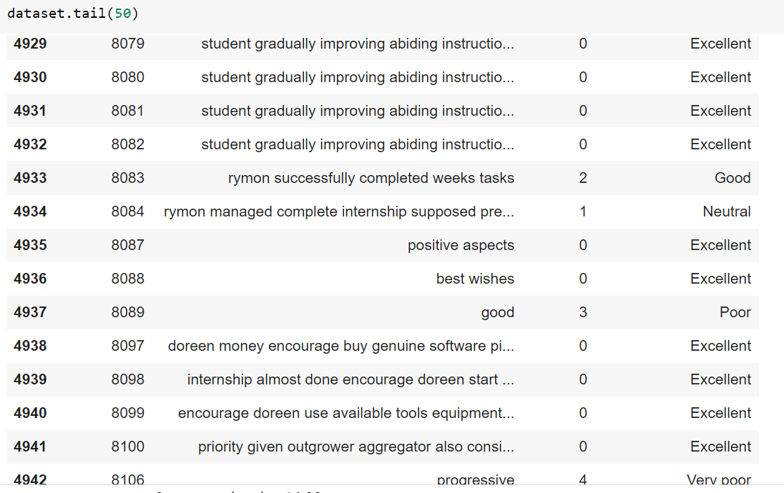
Comments category..

Slide 14
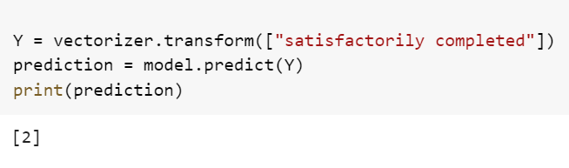
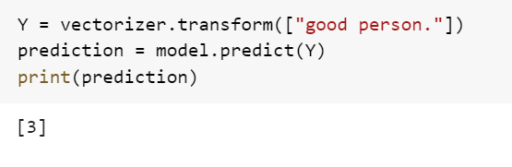
Predictions

Slide 15
Model evaluation with silhouette
I used a silhouette score to determine the performance of the algorithm. With the increasing number of the k value in training, led to;
The increase in silhouette score.
For example;
with k=10, silhouette score was at 0.062.
with K=20, silhouette score was at 0.8,
with k=200, silhouette score was at 0.115.

Slide 16
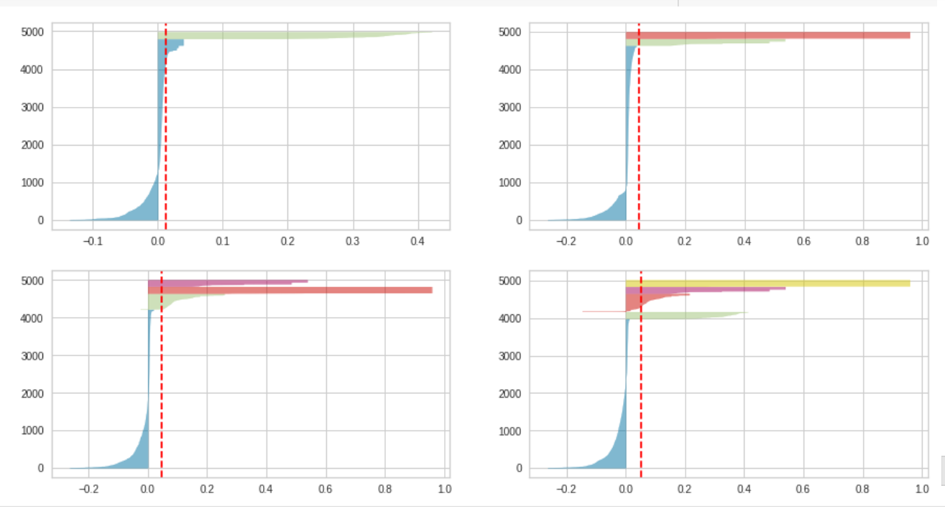
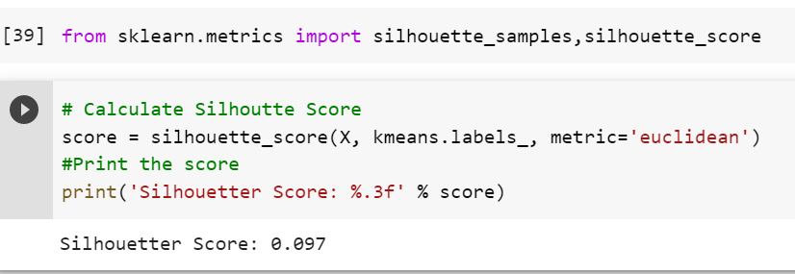
Model evaluation with silhouette..

Slide 17
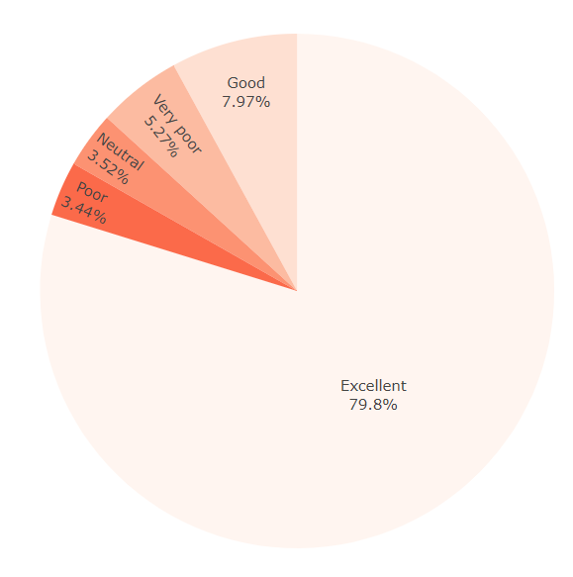
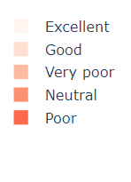
Percentage per category

Slide 18

Word cloud from the corpus

Slide 19
Named Entity Recognition (NER)
Tools used
SpaCy
NER Annotator
Displacy
Used a text file.
Performed data annotation with NER annotation tool.

Slide 20
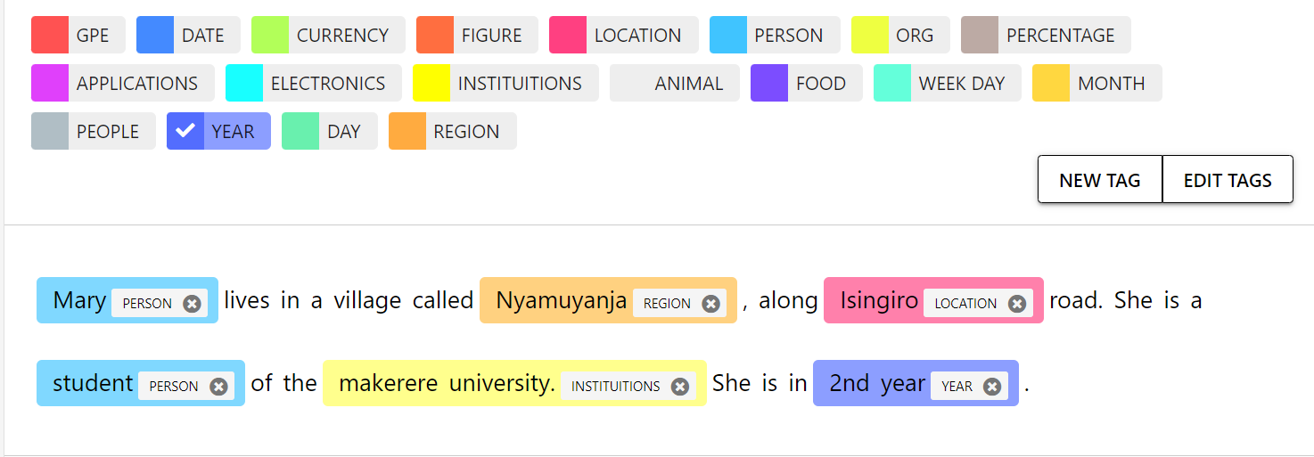
Data annotation

Slide 21
Data processing
Annotated data was exported as a json file.
Then converted into Spacy format by the inbuilt spacy configurations.
This conversion helps in processing and training of the data.

Slide 22
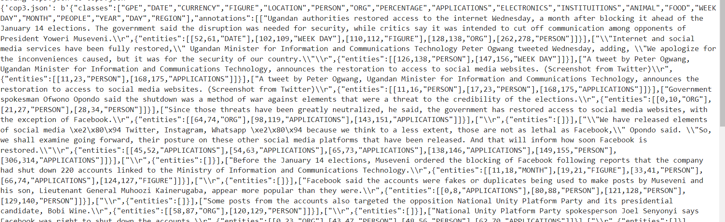
Json data

Slide 23
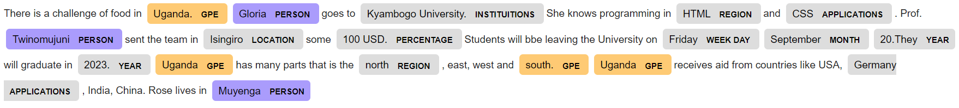
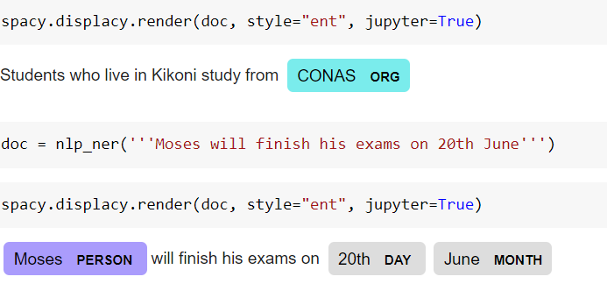
Results

Slide 24
Predictions from the NER
Entities that were correctly identified are ;
Uganda :GPE
Gloria :Person
Kyambogo University: Institutions
CSS :applications
Twinomujuni :Person
Isingiro : Location
Friday: Weekday
September: Month
2023 :Year
North: Region

Slide 25
Predictions from the NER..
Incorrectly predicted
HTML: region
100 USD :percentage
Germany :Application
Muyenga :Person

